Slide 1
Intermediate Python Part 2
Workshop Lead:
Month Date, Year

Slide 2

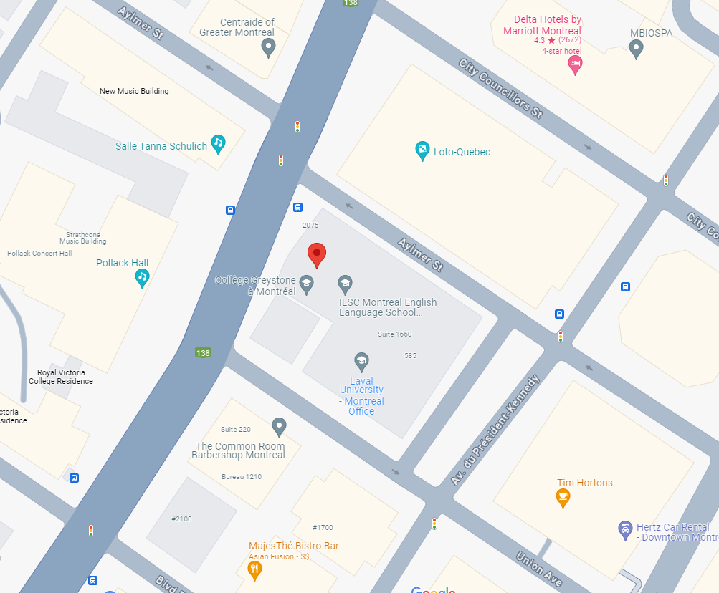
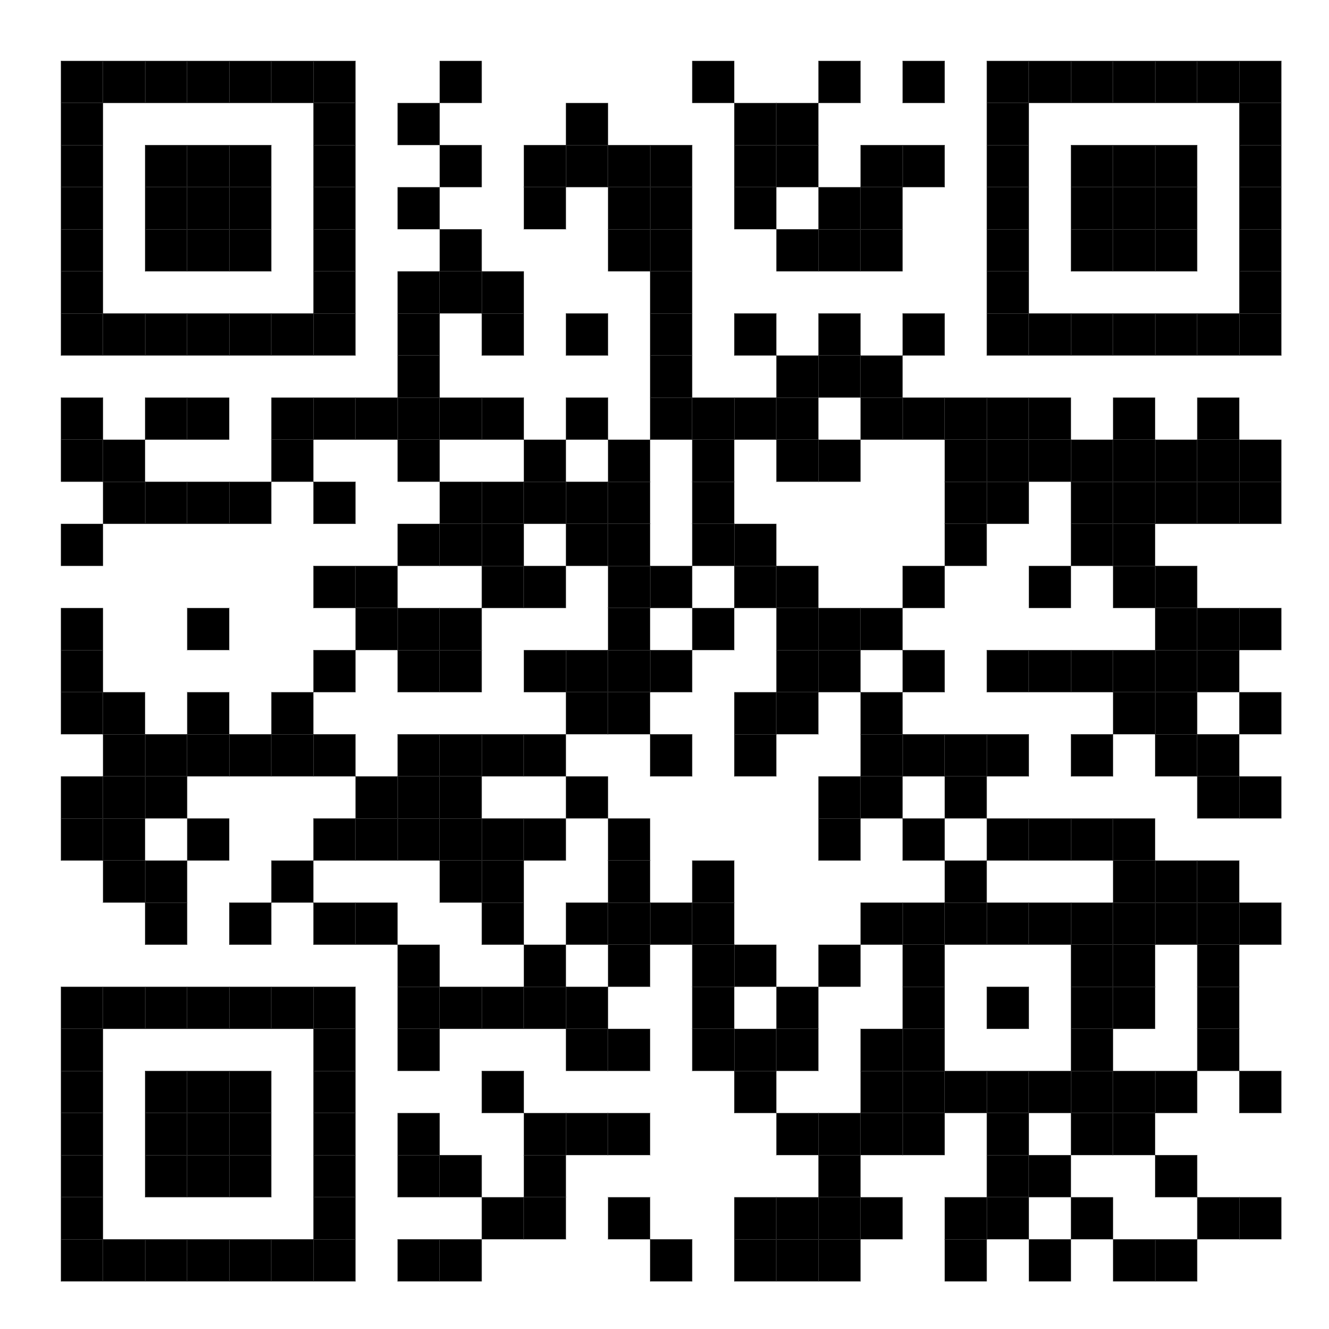
QLS-MiCM mission statement: deliver quality workshops designed to help biomedical researchers develop the skills they need to succeed.
Location: 550 Sherbrooke Street, Montreal, Quebec
Scan the QR code to sign up
for our mailing list
Contact: workshop-micm@mcgill.ca

Slide 3
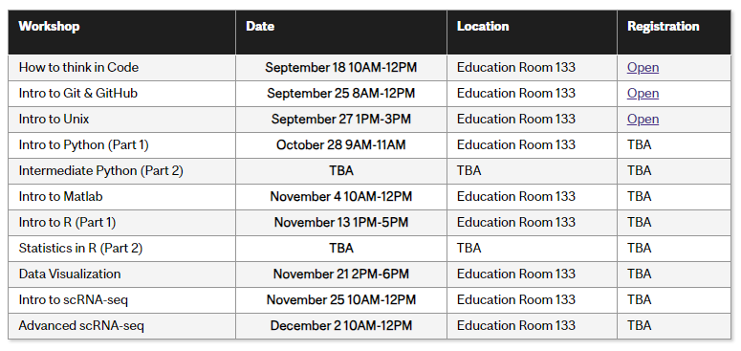
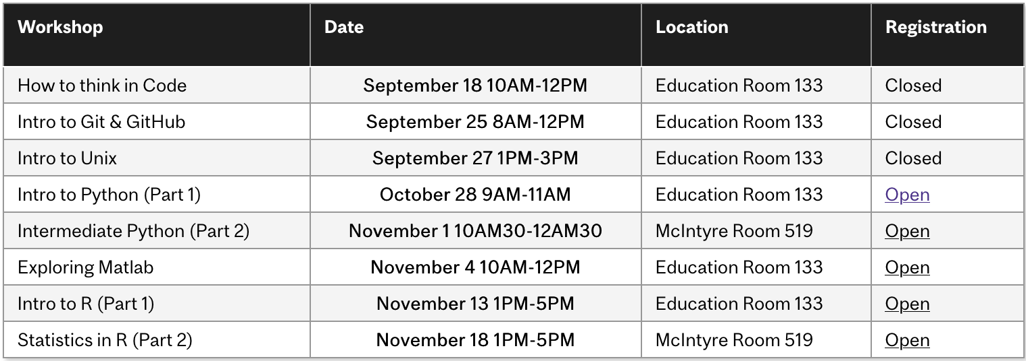
Workshop Series
https://www.mcgill.ca/micm/training/workshops-series

Slide 4
Outline
Module 1 – Getting Up to Speed (10 minutes)
Quick Review
Module 2 – Introduction to Functions (45 minutes)
Function Overview
Writing Custom Functions
Documenting Functions
Exercise
Module 3 – Modules and Packages (45 minutes)
Using Modules
Package and Environment Management
Exercise: Using textwrap to nicely print DNA sequences.
Module 4 – Where to go from here (10 minutes)
What to learn next? How?
How to get help and how not to get help
Glimpse of other cool programming topics

Slide 5
Module 1 Getting Up to Speed

Slide 6
What is Python?

Slide 7
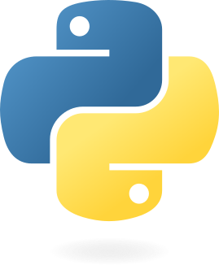
Welcome to the Python Programming Language!
For more history: https://en.wikipedia.org/wiki/History_of_Python
Introduced in 1991 by Guido van Rossum
Features:
Free and Open Source
Interpreted
Object-Oriented
https://python.org

Slide 8
Free and Open Source
Everyone is free to: download, use, modify and redistribute Python.
Python is developed, in part, by the community of users.
https://docs.python.org/3/license.html

Slide 9
Interpreted
Gene Expression
DNA
mRNA
Protein
Program (text file)
Executable (binary instructions)
Interpretation (line-by-line)

Slide 10
Object-Oriented
DNA
transcribe()
sequence
RNA
sequence
translate()
Protein
sequence
Data
Behaviour

Slide 11
Key Ideas and Syntax

Slide 12
Variables & Data Types
# Primitive Data Types
my_str = "Hello!"
my_int = 5
my_float=4.5
my_bool = False
# Collection Types
my_tuple = (404, "Not Found")
my_list = ["A", "G", "C", "U", "T"]
my_dict = {
"purines": ["A", "G"],
"pyrimidines": ["C", "T", "U"],
}
Variable name must contain only letters, numbers and underscores. Can’t start with a number!

Slide 13
Control Flow
if block is required!
if some_boolean:
run_some_code()
...
elif some_other_boolean:
run_other_code()
...
elif yet_another_boolean:
run_other_other_code()
...
else:
run_code_if_no_match()
...
run_code_regardless()
Python relies on indents to define blocks.
elif blocks are optional; no fixed number.
Maximium one else block.
If you stop indenting, the code runs regardless.

Slide 14
Loops
(Almost) never use a raw Boolean.
# while loop
while some_boolean:
run_some_code()
...
update_boolean()
run_other_code()
# for loop
for variable in some_iterable:
run_some_code()
run_other_code()
Update the Boolean during the loop.
Block is defined by indents.
Block is defined by indents.
variable gets updated automatically by taking the next value.

Slide 15
Interactive Workshop!
Let’s go to a Jupyter Notebook:
To the repository!

Slide 16
Module 3 Modules and Packages

Slide 17
Environments
Project 1
Python 3.9
NumPy 1.26
Project 2
Python 3.11
NumPy 2.0
Project 3
Python 3.8
scikit-image 0.21
SciPy 1.12
Matplotlib 3.6
scikit-learn 1.2
Matplotlib 3.3
PyQt5 5.15.5

Slide 18
To summarize
Functions define chunks of reusable behaviour that we can easily call again. Functions should be documented using docstrings.
Python uses a system of modules to allow easy reuse of code.
Modules can be built-in, user-defined or included in packages.
There are various tools to install packages, including pip and conda.
Projects can use environments to manage dependencies.
Now you are ready to:
Define and call new functions.
Import and use code from built-in Python modules.
Install new packages to access even more tools.

Slide 19
Acknowledgements
Thank you to QLS-MiCM for giving me this opportunity and for helping me along the way.
Thank you to the professors from the McGill School of Computer Science for helping me along my programming journey and for inspiring me to share my programming experience with others.
Thank you to Professor Mathieu Blanchette, whose COMP 204 course helped introduce me to Python (back in Fall 2018).
Thank you to the Python community!

